Slide 1
MarketFlash Project
Enhancing Business Operations with Data Insights
Lillian Fuchs
DR. Nancy Wanja
Vani Prasad
Sumaya Parvin
Florence Kirmes

Slide 2
Introduction
We will be presenting to you the project we've been working on for MarketFlash, a growing marketing company. Our goal was to design and build a powerful database and an insightful dashboard to help MarketFlash manage their data more effectively and make informed business decisions.
Link to Video Presentation
Notes:
https://drive.google.com/file/d/1ZNyPEeGi7GL4ajJ8_wHhrTLSzK9d4uXj/view?usp=drive_link

Slide 3
Project Objectives
Our main objectives for this project were to:
Transition Market Flash's data from spreadsheets to a more scalable and structured database.
Design a database that captures all necessary information about campaigns, clients, channels,and employees.
Create a user-friendly dashboard that provides clear visibility into business performance and key metrics.
MarketFlash initially faced several challenges:
Managing a large volume of data in spreadsheets, which was becoming inefficient and error-prone.
Lack of centralized data storage, making it difficult to retrieve and analyze information.
The need for a comprehensive dashboard to visualize key business metrics and trends.
To address these challenges, we followed a structured methodology:
Conducted interviews with Markus to understand the business requirements.
Analyzed the existing data to design a functional ER diagram for the database.
Cleaned the data to ensure accuracy and consistency.
Implemented the database design using SQL, ensuring all keys, datatypes, and constraints were correctly set up.
Created and iterated over a dashboard design based on Markus’s feedback, using Tableau for visualization."

Slide 4
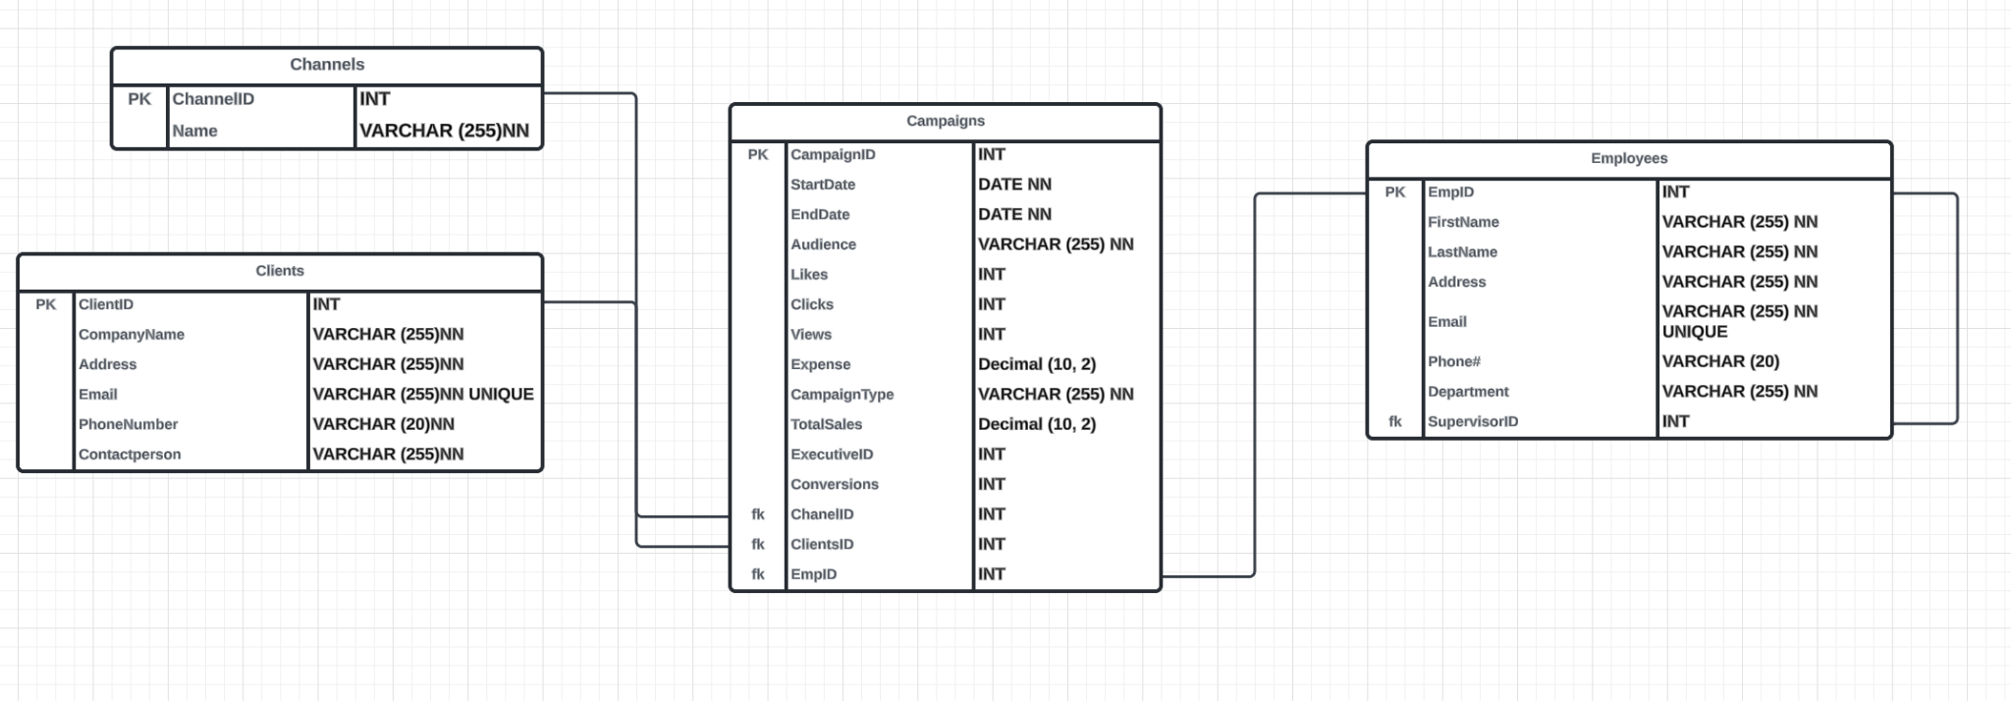
FUNCTIONAL ER Diagram
"This is the ER diagram we designed for MarketFlash’s database. It includes four main entities: Campaigns, Clients, Employees, and Channels, along with their relationships. Each campaign is associated with one client, one channel, and one employee managing it. This structure ensures data integrity and supports efficient querying and reporting."

Slide 5
Database
We Normalized our database and removed redundancy.
We identified several data quality issues. These include: Duplicate records, missing values, Inconsistent data formats.
After cleaning the data, we achieved a significant reduction in duplicates and improved the completeness of our data. This has enhanced the reliability of our market analyses and decision-making processes.
Link to SQL code
Notes:
https://docs.google.com/document/d/1iCElMeUvEEOrwoSYB77B3uzam4G-qRfgTajYBdUFy1c/edit

Slide 6
Dashboard overview
Let's dive into the dashboard we created for MarketFlash. This dashboard provides a comprehensive view of the key performance indicators and insights necessary for making informed marketing decisions.
Top Metrics: (Avg.Clicks: 2,607, Avg.Conversions: 510, Avg.Likes: 5,049, Avg.Views: 50,404)
Conversion Rate: (Email: 21.17%, Facebook: 19.99%, Instagram: 17.68%, TikTok: 20.25%, YouTube: 18.12%)
Engagement by Location and Audience: (likes, clicks, views)
Channels Cost per Metric:(Email: 0.28429, Facebook: 0.22527, Instagram: 0.26154, TikTok: 0.22622, YouTube: 0.25800)
Clients Performance:( Shows Performance metrics broken down by client.)
Quarterly Engagement Analysis:(Breaks down engagement metrics by quarter)
Sales by Territory:(Shows sales data broken down by territory and channel)
ROI (Return on Investment):(Shows the return on investment for each channel. )
Link to Tableau

Slide 7
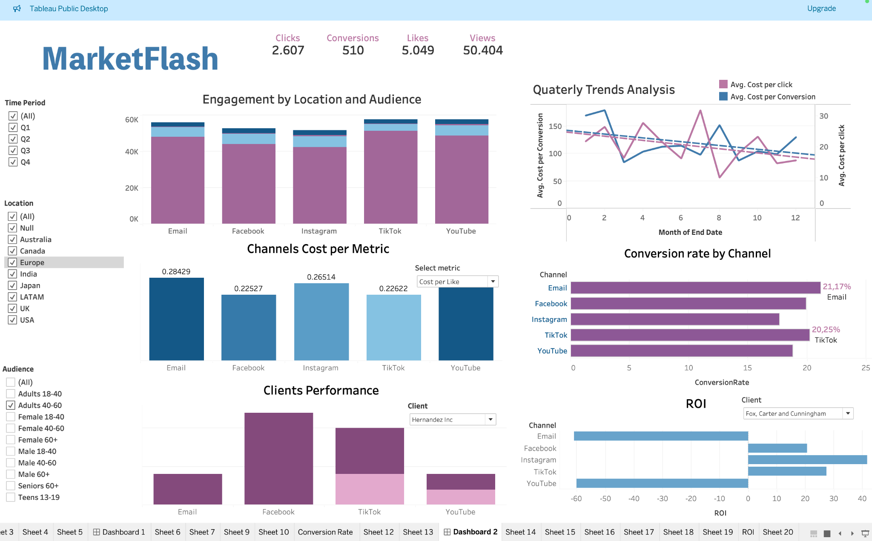

Slide 8
Conclusion
Our analysis provided valuable insights into campaign performance, helping
MarketFlash make data-driven decision
This dashboard brings together a wealth of data to provide a holistic view of MarketFlash marketing performance. This allows a quick and easy analysis of key metrics, enabling better decision-making and more effective allocation of marketing resources.

